Slide 1
Heat Transfer
Lecture 1

Slide 2
Introduction to heat transfer
Difference Between Heat Transfer and Thermodynamics:
Heat transfer is a science which predicts the energy transfer between two bodies due to temperature difference.
Thermodynamics teaches us this energy is heat.
Heat transfer explains how energy will be transferred and the rate of that transfer.
Thermodynamic deals with systems in equilibrium. It may use to predict the amount of energy required to change a system from one equilibrium stage to others. It may not be used to predict how fast this change will occur.
Heat transfer supplement 1st and 2nd law of thermodynamics and also additional experimental rule which is used to predict the transfer rate.

Slide 3
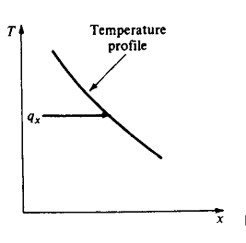
Heat transfer by Conduction
Conduction heat transfer: Fourier’s law of Conduction
Heat transfer rate per unit area is proportional to temperature gradient:-
q = heat transfer rate
= Temperature gradient
K = Thermal conductivity
(-) sign indicate heat flows downhill in temperature scale.

Slide 4
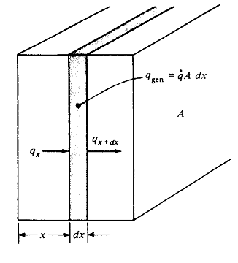
Conduction heat transfer
One dimensional Conductional heat transfer:
Energy conducted in left face + Energy generated in within element = Change in internal energy +Energy conducted if right face

Slide 5
Conduction heat transfer
Combining above equation:

Slide 6
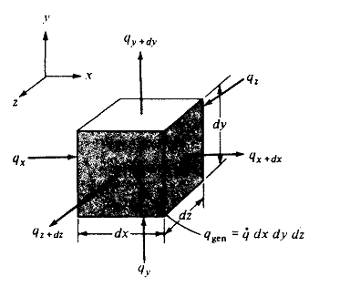
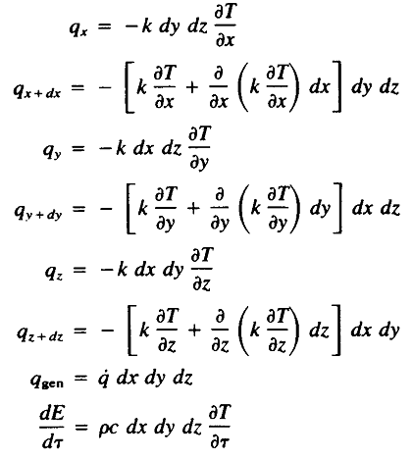
3D Conduction heat transfer
For three dimension heat conduction:

Slide 7
3D Conduction heat transfer
General 3D conduction Equation:
For constant conductivity:
= Thermal diffusivity of a material

Slide 8
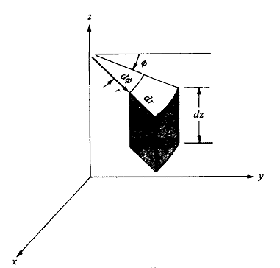
3D Conduction HT: Cylindrical Co-ordinate

Slide 9
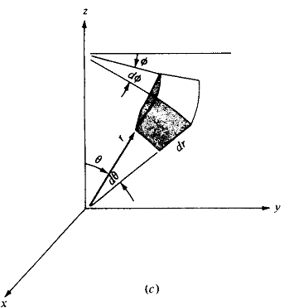
3D Conduction HT: Spherical Co-ordinate

Slide 10
General Equations of heat transfer for some specified conditions

Slide 11
Thermal Conductivity
Conductivity of Gases: kinetic theory at moderately low temperature
At high temperature region, the molecules have the higher velocity than the low temperature region.
Molecules are in continuous random motion, colliding with each others and exchanging energy and momentum.
If molecules move from higher temperature region to low temperature region, it transport kinetic energy to low temperature region through collision with low temperature molecules.

Slide 12
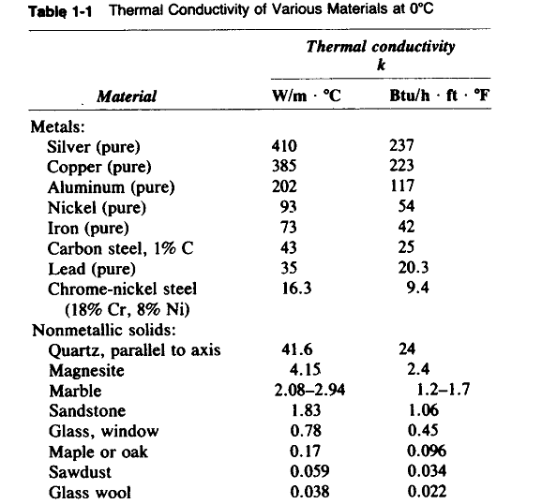
Thermal Conductivity

Slide 13
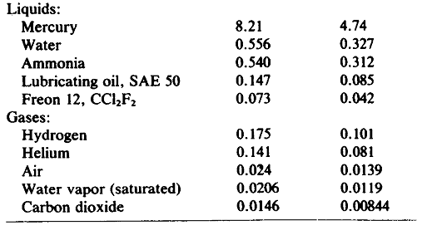
Thermal Conductivity

Slide 14
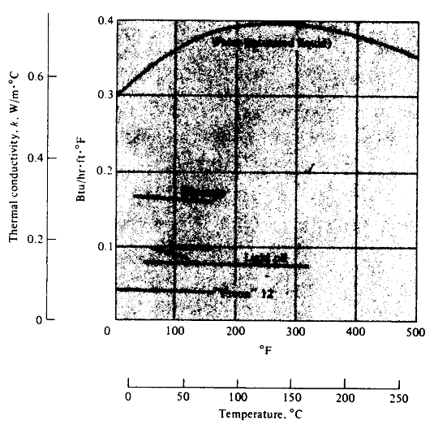
Thermal Conductivity

Slide 15
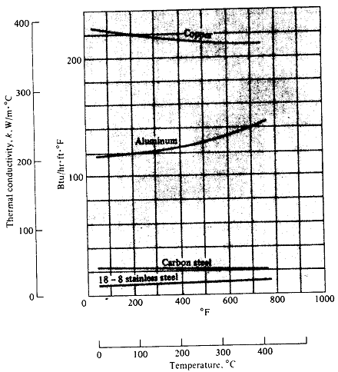
Thermal Conductivity

Slide 16
Thermal Conductivity

Slide 17
Energy transfer in insulating material
Methods of energy transfer in insulating materials:
Conduction through fibrous/ porous solids materials.
Conduction through air trapped in void space.
At sufficient high temperature radiation occurs.

Slide 18
Storage of Cryogenic Materials
Liquid H₂ storage: at 23K
Superinsulators are used which consists of multilayer of highly reflective material separated by insulating spacer.
Entire system is evacuated to avoid air thermal conduction.

Slide 19
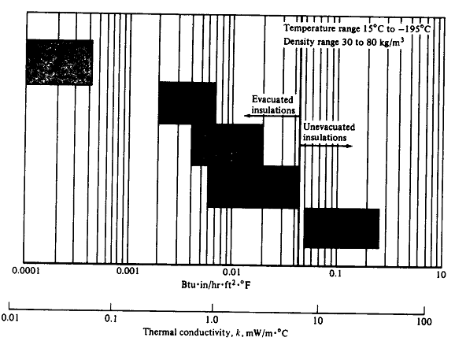
Storage of Cryogenic Materials

Slide 20
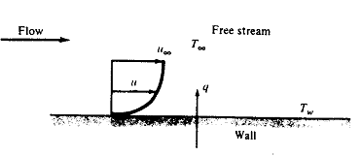
Heat Transfer by Convection
Newton’s law of Convection:
h = convection heat transfer coefficient
= Film conductance

Slide 21
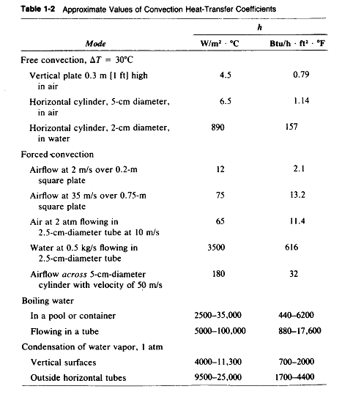
Heat Transfer by Convection

Slide 22
Heat Transfer by Radiation
Thermodynamic consideration shows that ideal thermal radiator or black body will emit energy at a rate proportional to fourth power of absolute temperature of body and directly proportional to it’s surface area.
Net exchange between two surface:

Slide 23
Heat Transfer by Radiation
Considering the gray nature of surface:
Fε = Emissivity function
F_{G} = Geometric view factor
Radiation in an Enclosure:

